Slide 1

Reviewer
Final Presentation
Your go-to guide for everything local - REVIEWER!
Team 4
Sanjeev Kumar
Nayan Yadav
Bisheng Zeng
Kaushal Dobariya
Vaibhav Babariya
Prasad Menda
Vignan Kasam
Sai Kiran Bokkola

Slide 2
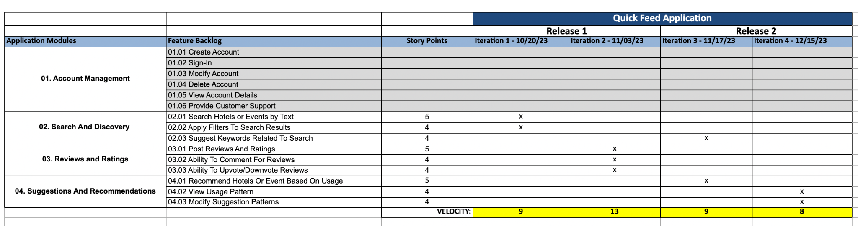
Road Map (Nayan Yadav)

Slide 3
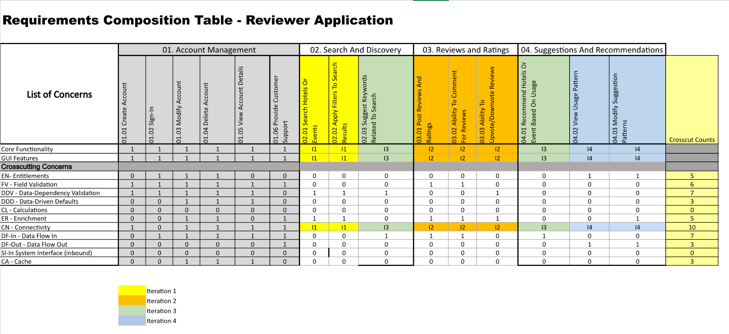
RCT (Prasad)

Slide 4
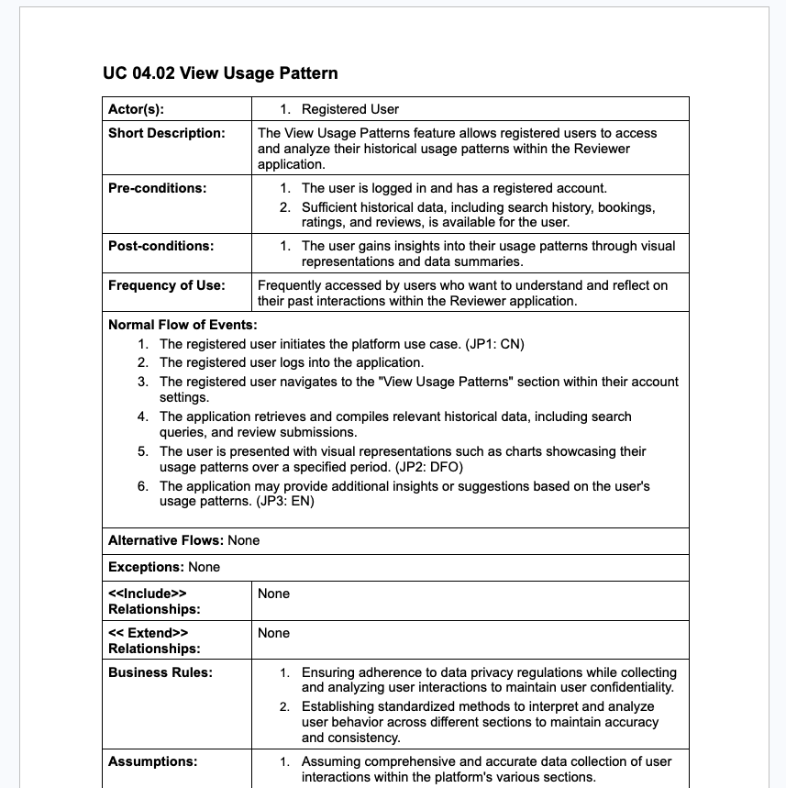
Use Case Specification (Vignan)

Slide 5
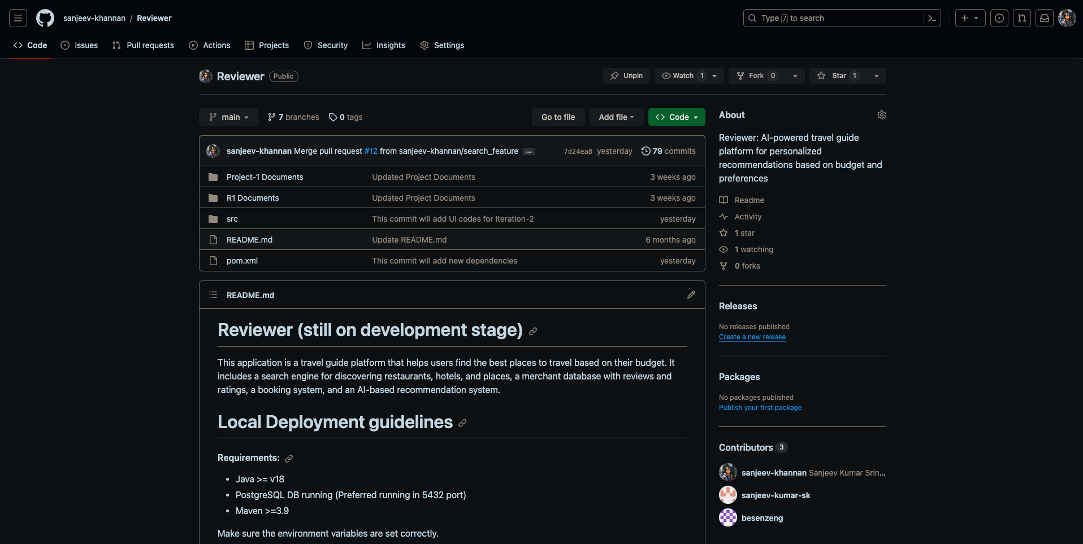
Github Folder (Sai Kiran)

Slide 6
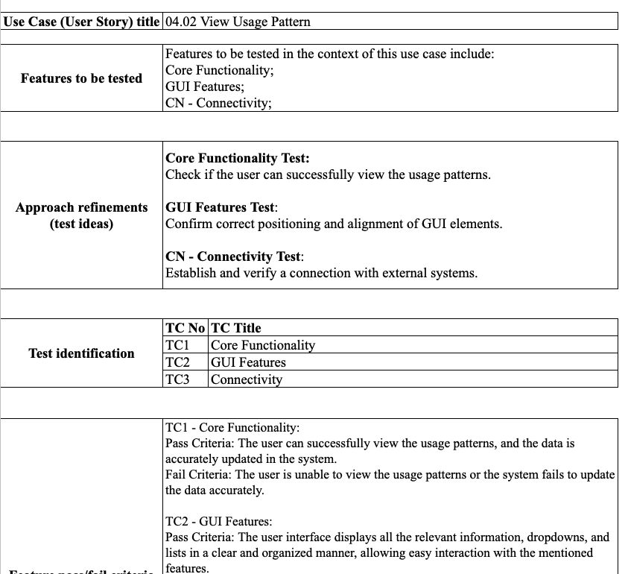
Acceptance Tests (Kaushal)

Slide 7
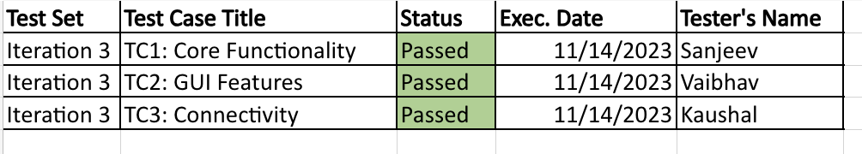
Test Execution Log (Vaibhav)

Slide 8
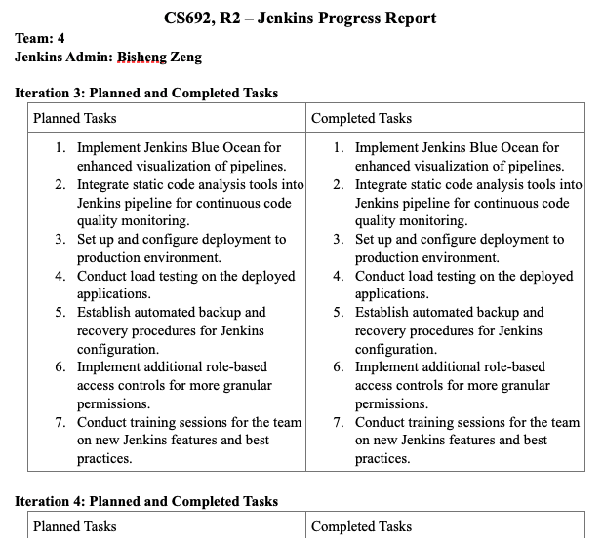
Jenkins Progress Report (Bisheng)

Slide 9
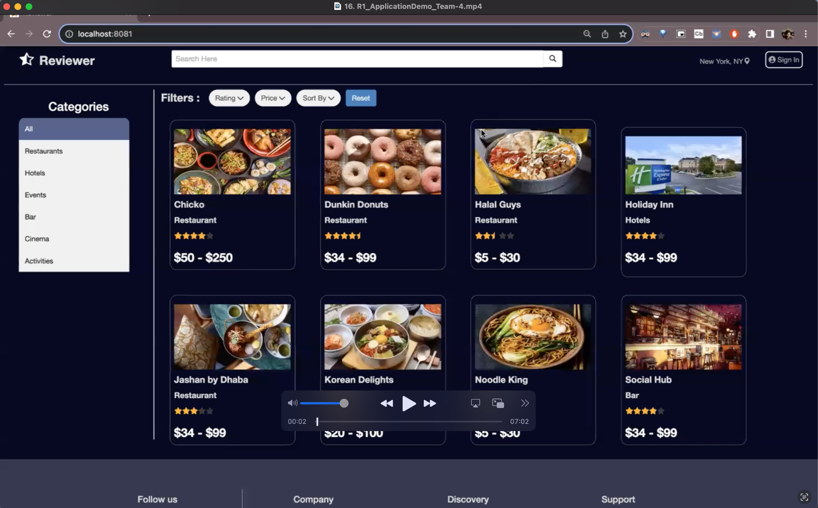
Recorded Demo (Sanjeev)

Slide 10
Thank you

